Slide 1
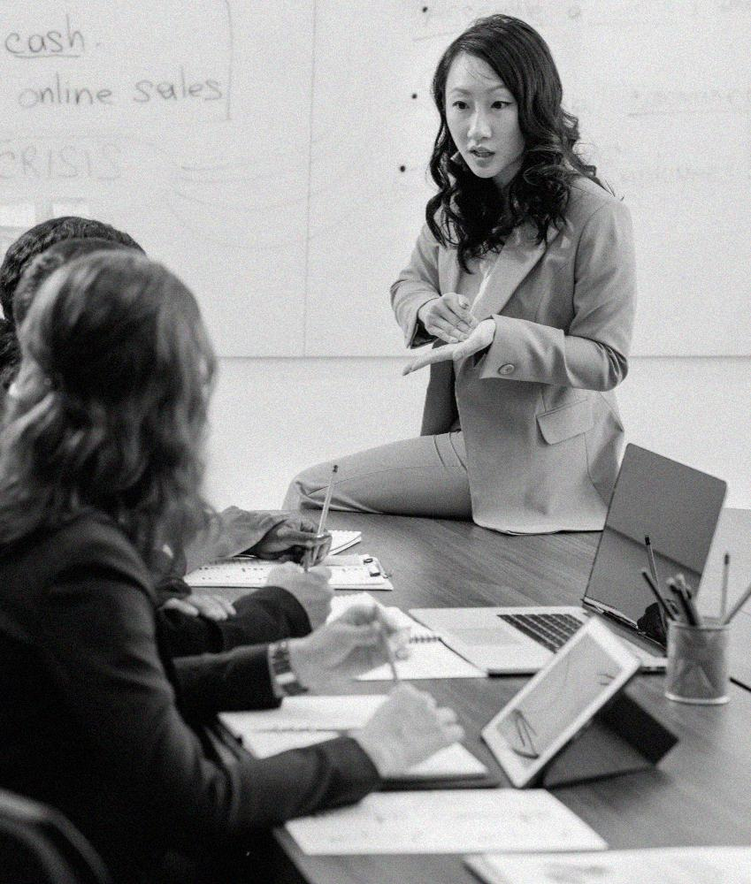
Project Assignment #1
Analysis regarding Yellevate’s dispute problem

Slide 2
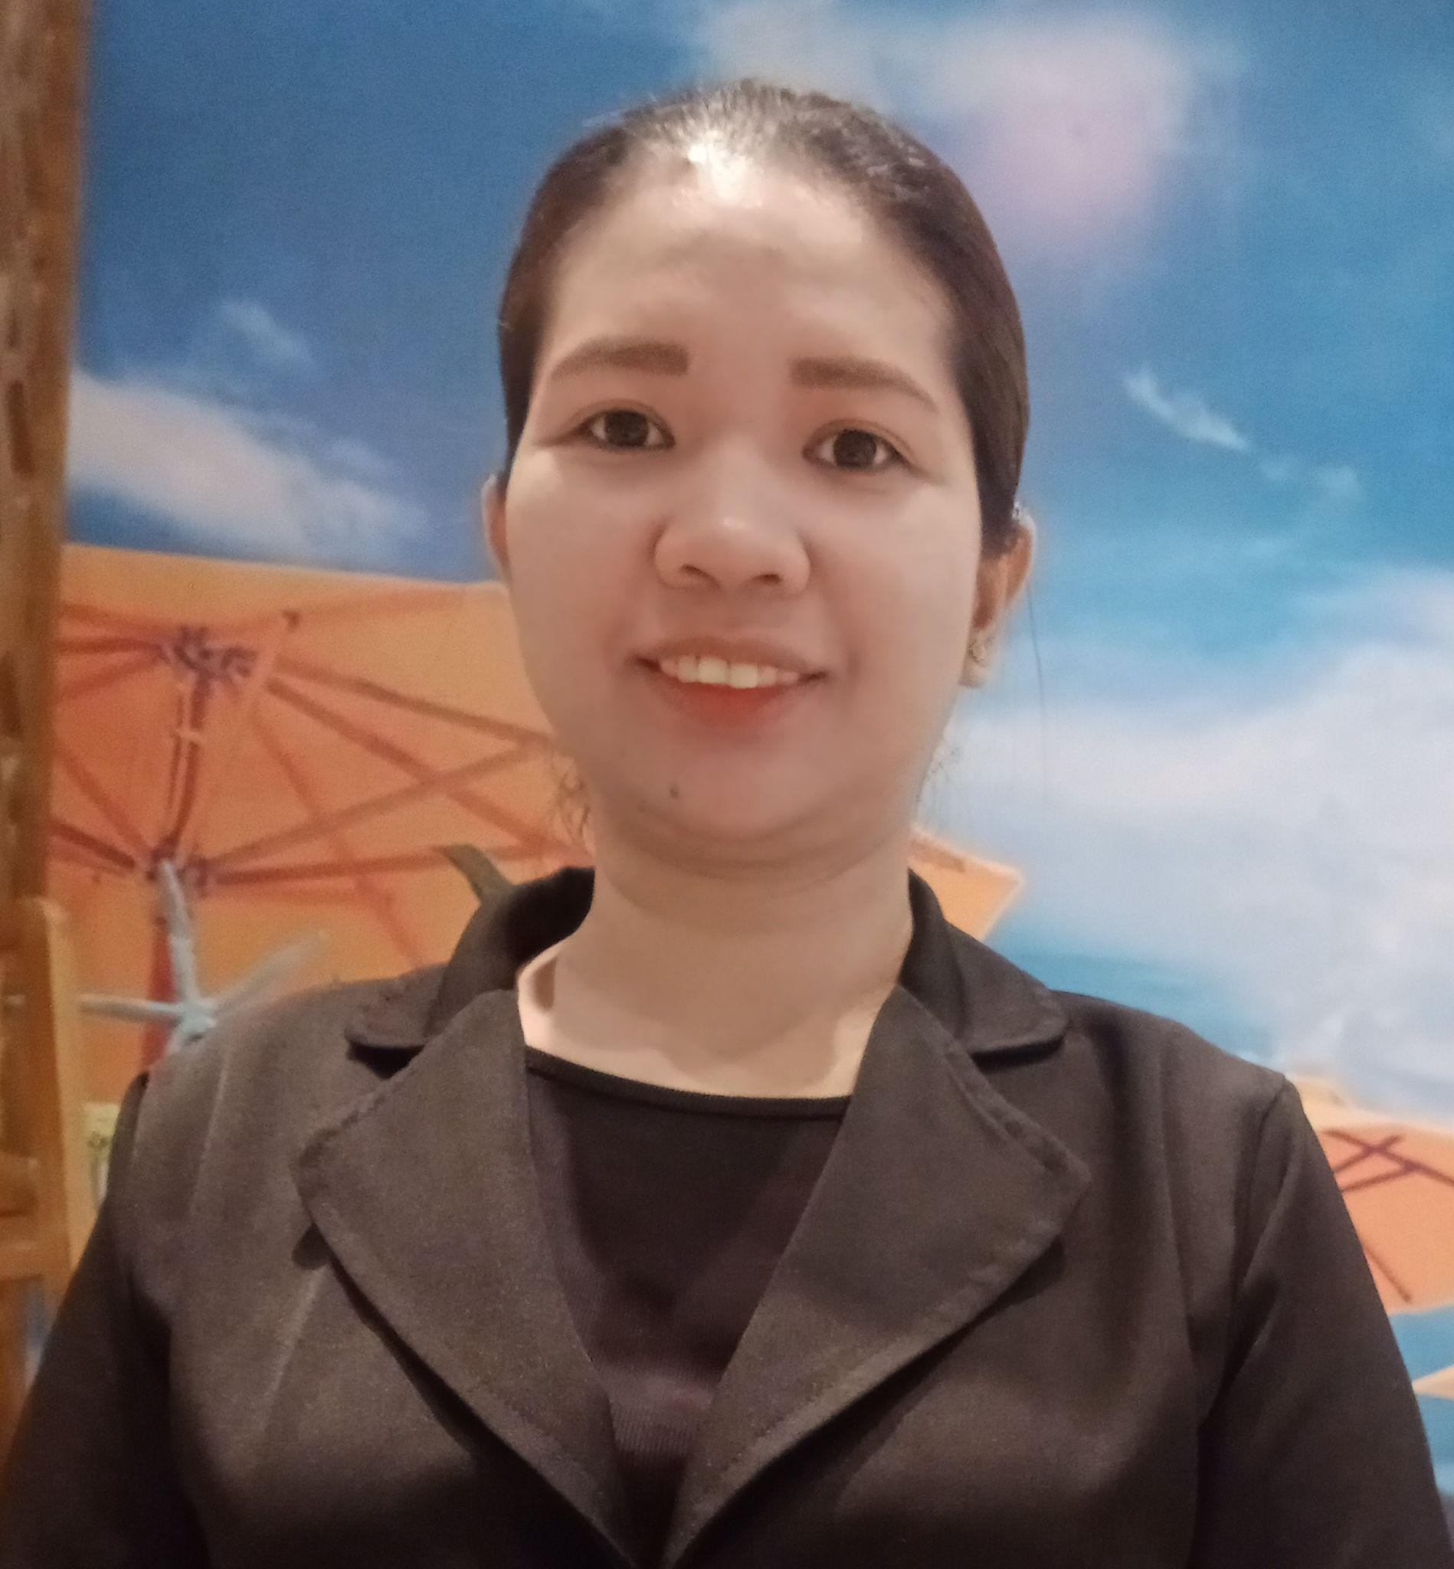
INTRODUCTION
Hi! My name is Genevieve Gonzales
Graduate of Bachelor of Science in Business Administration major in Marketing Management in University of Southern Mindanao - Kabacan, North Cotabato
Currently working as Service Leader in R2 Group of Exclusive Brands
Linkedin: https://www.linkedin.com/in/genevieve-gonzales-a4b8b116a/

Slide 3
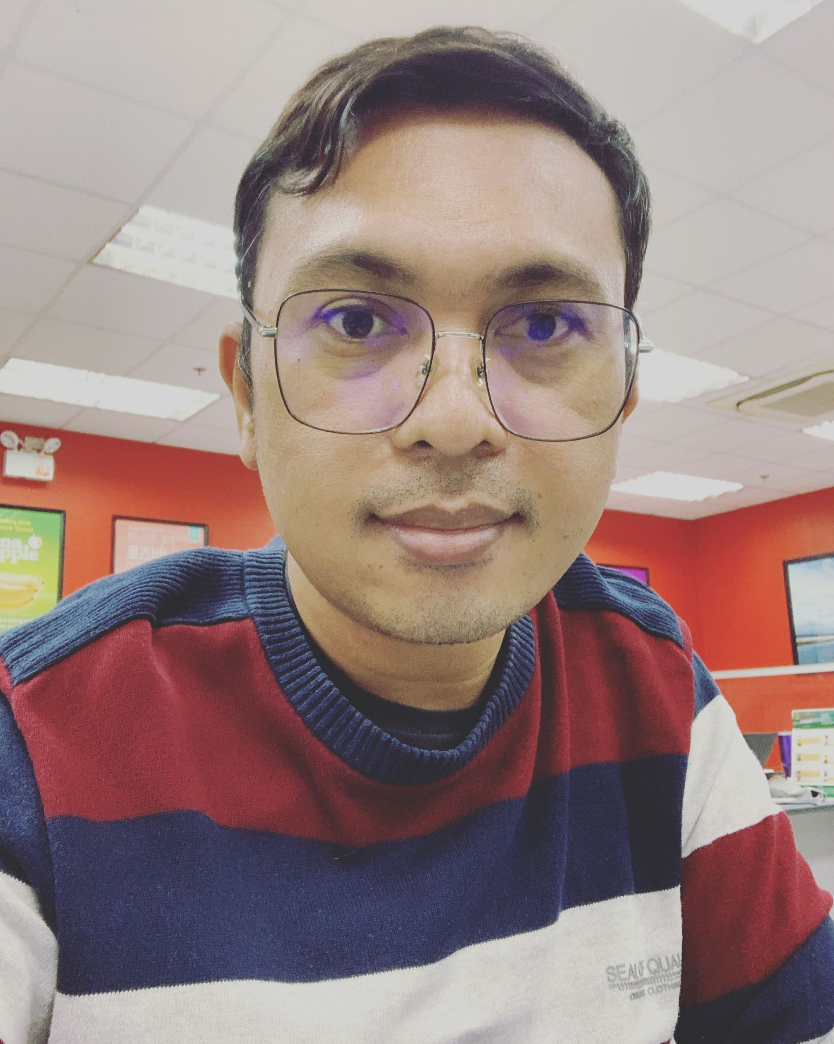
INTRODUCTION
Hi! My name is Eddie Jr P. Galarce
Graduated in BS Computer Science in University of Southeastern Philippines on 2004
Employed in Banana company based in Davao City from 2005 to the current year
Took Web Development Online Course on 2012 - 2014
Earned Accounting Unit in AMA Online on 2016
Linkedin https://www.linkedin.com/in/eddie-jr-galarce-35299481/

Slide 4
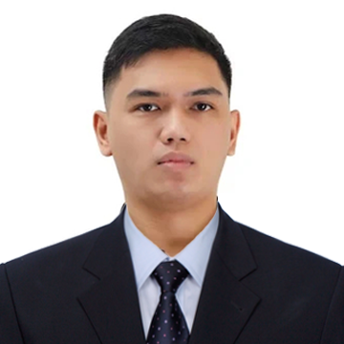
INTRODUCTION
Hi! My name is Kristian Elihu Glorioso
Graduated BS in Mechanical Engineering at Southern Luzon State University - Lucban, Quezon
Currently studying Professional Science Master’s Degree in Construction Management at Technological Institute of the Philippines - Quezon City
Currently employed as Fire Officer 1 at Bureau of Fire Protection

Slide 5
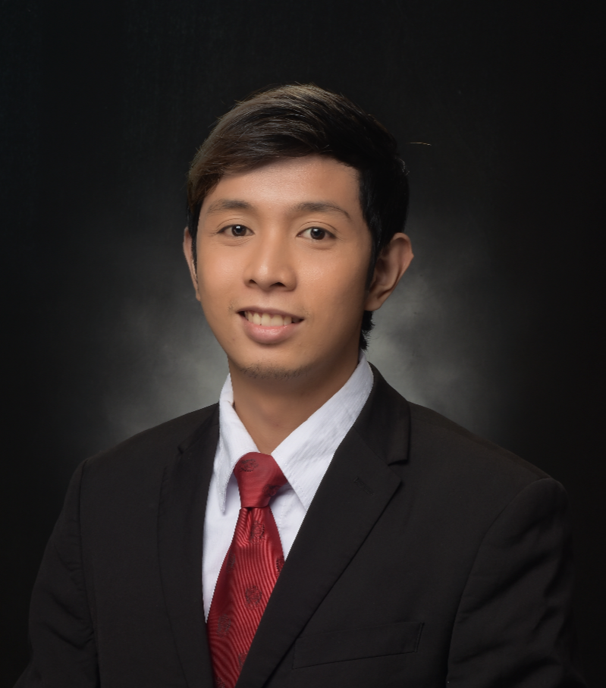
INTRODUCTION
Hi! My name is Neil Angelo Martinez
Graduated BS in Electronics Engineering at Lyceum of the Philippines University - Cavite
Linkedin: https://www.linkedin.com/in/neilangelomartinez

Slide 6
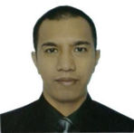
INTRODUCTION
Hi! My name is Onofre Vidad Jr.
Graduate of Bachelor of Computer Science and Bachelor of Information Technology in St. Paul University of the Philippines in Tuguegarao City, Cagayan
I was with Accenture Philippines as a Data Entry Analyst for 8 years. Also had 2 years of experience as a Customer Service Representative with Telus International Philippines.

Slide 7
TABLE OF CONTENTS
01
02
03
04
Project Overview and Goals
Key Findings
Insights
Recommendation

Slide 8
01
PROJECT OVERVIEW AND GOALS

Slide 9
PROJECT OVERVIEW
For the past few years, Yellevate has been struggling with client disputes. Yellevate defines disputes as clients expressing dissatisfaction with the company’s services and refusing to pay for them.

Slide 10
PROJECT GOALS
The processing time in which invoices are settled (average # of days rounded to a whole number).
The processing time for the company to settle disputes (average # of days rounded to a whole number).
Percentage of disputes received by the company that were lost (within two decimal places).
Percentage of revenue lost from disputes (within two decimal places)
The country where the company reached the highest losses from lost disputes (in USD).
Notes:
Executives at the company decided that the following information should be obtained to identify the circumstances around the dispute problem:

Slide 11
02
KEY FINDINGS

Slide 12
1. The processing time in which invoices are settled
Russia has the longest average processing time of 29 days, which is 22.81% longer than China, which has the shortest data of 23 days. Furthermore, the average processing time for the entire dataset is 26 days.

Slide 13
2. The processing time for the company to settle disputes
Russia has the highest average processing time of 5 days, which is 2.5 times faster than China, which has an average processing time of 2 days. Furthermore, the average processing time for the five countries is three days.

Slide 14
3. Percentage of disputes received by the company that were lost
France has the highest percentage of lost disputes of 34.23% which is 9 times higher than United States which only has 3.75% lost disputes.

Slide 15
4. Percentage of revenue lost from disputes
France has the highest percentage of revenue lost from disputes of 13.35% which is 15 times higher than United States which only has 0.84% lost disputes.

Slide 16
5. The country where the company reached the highest losses from lost disputes
Because France has the highest rate of lost disputes, the country with the biggest losses from lost disputes should be France.

Slide 17
03
INSIGHTS

Slide 18
INSIGHTS
Customers file a dispute with Yellevate because they expected a pandemic exception in their contract but were not given one. As a result, they decided not to pay their invoices or file a dispute. They believe that because of natural disasters, every company should make an exception for their customers.
Consider that the invoice dates occurred during the pandemic, which meant that employees were adjusting from their workforce. Furthermore, the lack of documentation from both parties, and the lack of communication caused the disputes to arise.

Slide 19
INSIGHTS
Aside from the invoices being settled late, there is no visibility into why they were late and why the invoices being disputed. It is suggested that we include more information in the dataset, such as the cause for the delay and why it is disputed.
With it, we can get a better understanding of the issue at hand and take the required steps to resolve it. For the time being, since the only ground for a dispute is "Late Settlement," we can ask the client how the settlement is progressing.

Slide 20
04
RECOMMENDATION

Slide 21
RECOMMENDATION
Yellevate and their customers must have an open communication with each other especially if one party wanted to change the contract.
Have a discussion with the customers and offering them freebies such as discounts on future service request in exchange for not opting out of their payment in order to reduce revenue loss.

Slide 22
THANK YOU!
Do you have any questions?

